Slide 1

Drug Review Sentiment Analysis
By: Myra Rust

Slide 2
Introduction
Background
$490 billion/yr revenue in U.S.
Court of public opinion
Objective: Build a model to provide customer sentiment based on text reviews
Purpose
Monitor brand/product sentiment

Slide 3


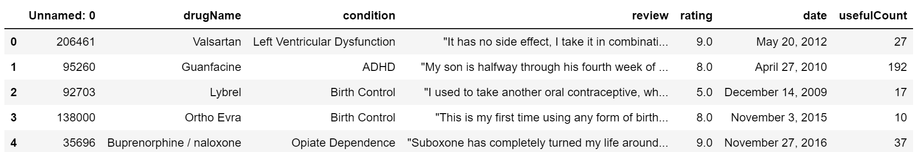



Dataset
Source (Gräßer et al., 2018)
161,297 training set / 53,766 test set
7 features
review = data for modeling
rating = target
Nans / parsing errors

Slide 4
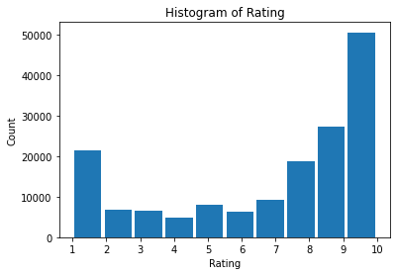
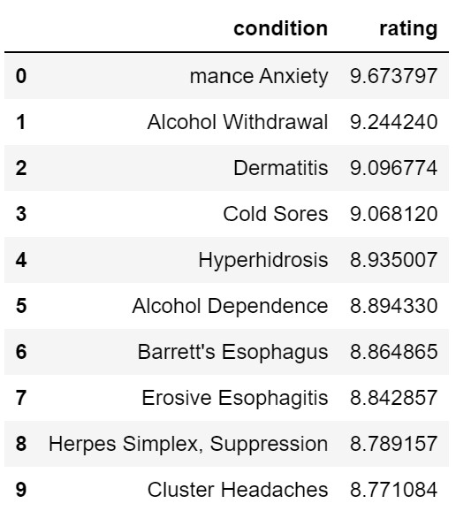
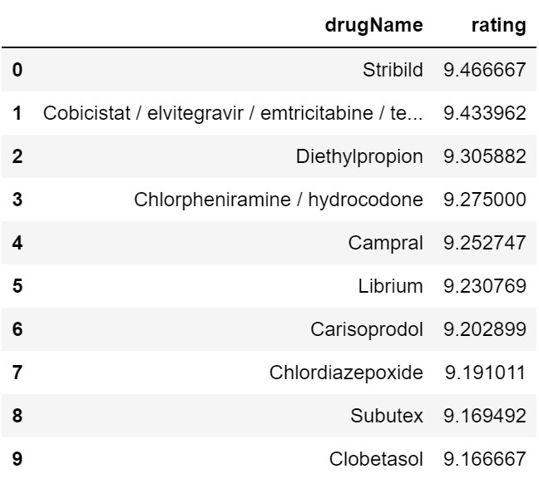
Preliminary Analysis

Slide 5
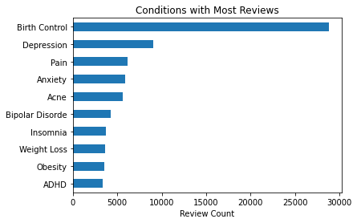
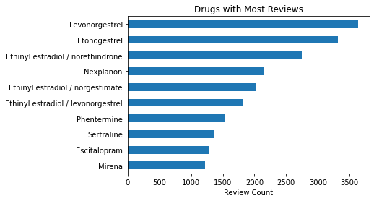
Preliminary Analysis

Slide 6
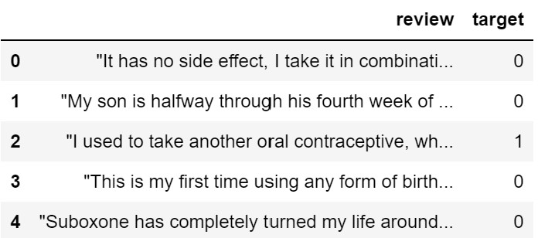
Data Transformation
Sentiment class assignment
Pos: 7+
Neutral: 5-6
Negative: ≤4
Train-test split
Preprocessing:
Convert to Arrays
Tokenization
Sequence Padding

Slide 7
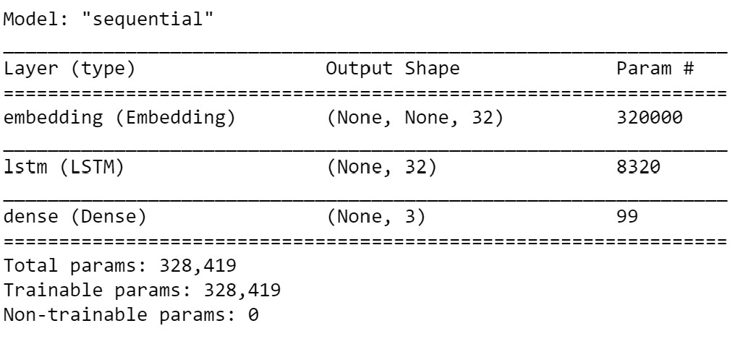
Model Selection
Problem: single-label multiclass classification
Recurrent Neural Network (RNN)
Embedding
LSTM
Dense
Model parameters
Loss function
Optimizer
Class weights

Slide 8
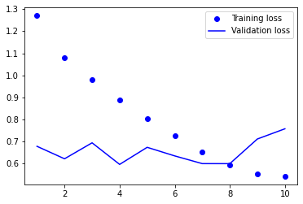
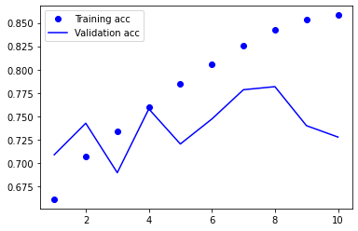
Model Evaluation

Slide 9
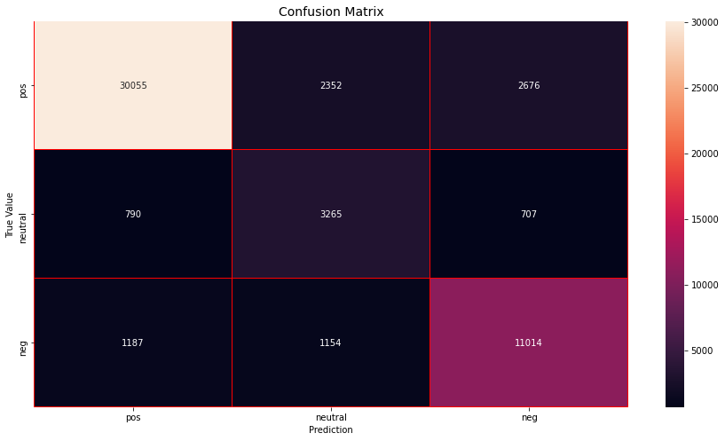
Results
Accuracy Score: 83.3%
Across the board
True positive most correct
Errors seem pretty even across remaining classes

Slide 10
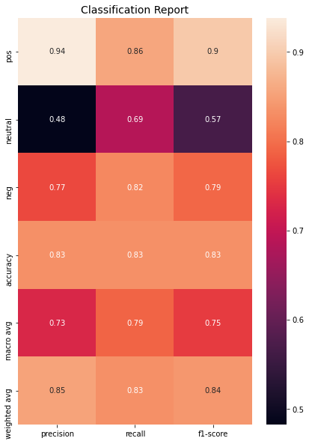
Classification Report
Precision
Recall
F1 score
Model weakness
Neutral reviews, why?

Slide 11
Conclusion
Project Success – 83.3% accuracy
Complex terminology
Measuring opinion / sentiment
Medical terminology

Slide 12
Future Work
Adjust sentiment class assignment
Competitive market
Neutral reviews
Provide little value
Are problematic for the model
Medical sentiment lexicon
Self creation
Becomes publically availible

Slide 13
References
Asghar, M. Z., Ahmad, S., Qasim, M., Zahra, S. R., & Kundi, F. M. (2016). SentiHealth: creating health-related sentiment lexicon using hybrid approach. SpringerPlus, 5(1), 1139. https://doi.org/10.1186/s40064-016-2809-x.
Chollet, F. (2018). Deep Learning with Python. Manning Publications: Shelter Island, NY.
Dua, D. and Graff, C. (2019). UCI Machine Learning Repository [http://archive.ics.uci.edu/ml]. Irvine, CA: University of California, School of Information and Computer Science.
Gräßer, F., Kallumadi, S., Malberg, H., and Zaunseder, S. (2018). Aspect-Based Sentiment Analysis of Drug Reviews Applying Cross-Domain and Cross-Data Learning. In Proceedings of the 2018 International Conference on Digital Health (DH '18). ACM, New York, NY, USA, 121-125. DOI: https://dl.acm.org/doi/10.1145/3194658.3194677.
Pharmapproach. (2020, November 1). 15 Astonishing Statistics and Facts About the U.S. Pharmaceutical Industry. Pharmapproach.com. Retrieved from https://www.pharmapproach.com/15-astonishing-statistics-and-facts-about-u-s-pharmaceutical-industry/.

